Slide 1


Quant Portfolio Management System
COMP4105 Designing Intelligent Agents
Kunal Choudhary
20590121

Slide 2


Story Time
Mr. Harilal approaches us on 25th April. He is deeply worried about his portfolio as he is keeping ill.
He current holds a stocks for 15 Indian companies across various industries.
He wants us to manage his portfolio by trading in stocks daily.

Slide 3

Quant Portfolio
Management System
Blueprint

Slide 4

Overall Structure
Stock Price
Forecasting Agents
Experimentation
Forecasted
Closing price
Portfolio Optimization (PO) Agents
Weights
Trading Agent
Evaluation

Slide 5
Decision Making
Forecaster
Decision Making : What will be tomorrow’s closing price?
How : Analyse historical data.
Portfolio Optimizers
Decision Making : How much to invest in each stock?
How : Analyse historical data + Forecaster’s decision
Trader
Decision Making : When to buy/sell?
How : Analyse how stock price is behaving.

Slide 6
Family Structure
“Forecaster + 4 PO Agents” makes one family of agents.
We have 4 Families. We have 4 PO Agents in each family.
Thus, 16 intelligent agents + 1 common trading agent, in total.
Forecaster
PO Agent 1
PO Agent 2
PO Agent 3
PO Agent 4
Trading Agent

Slide 7
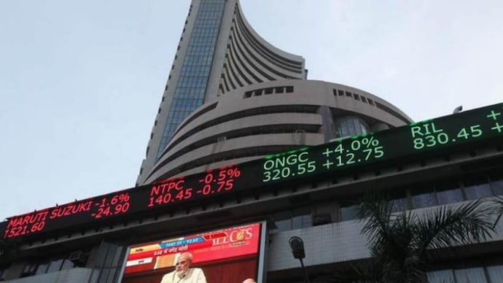


Environment

Slide 8






Portfolio
IT Services
Banking
Hotel Industry
Petrochemical & diversified
FMCG

Slide 9






Portfolio
Textiles
Airline
Power
Telecommunications
Pharmacy

Slide 10






Portfolio
Green Energy
Chemicals
Insurance
FMCG
Automobile

Slide 11

Forecasting Agents

Slide 12

Modelling Timeline
Mr. Harilal arrives
1st Jan
2023
26th Feb
2024
25th Apr
2024
26th Apr
2024
9th May
2024
Training
data
Test
(60 trading days)
Final Evaluation
(10 trading days)

Slide 13
Forecasting Agents
SNaïve
Seasonal
ARIMA
Support
Vector
Machine
Elman
Neural
Network

Slide 14

Forecasting Agent 1
SNaive agent simply takes the last known value and forecasts it as the prediction.
Forecast tomorrow = Today’s price
SNaïve

Slide 15
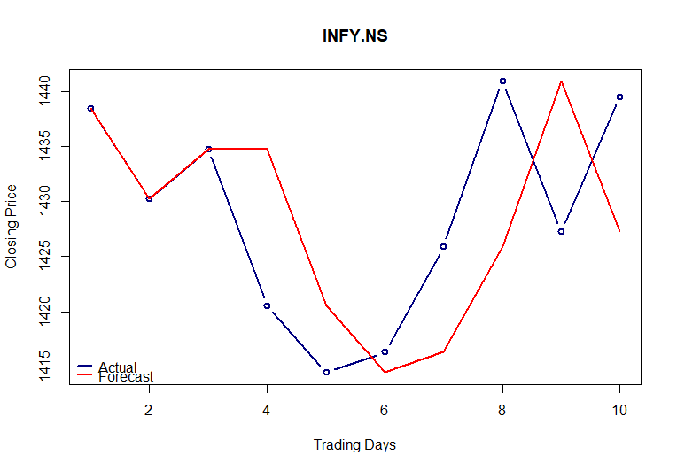
10 Trading-days’ Performance

Slide 16
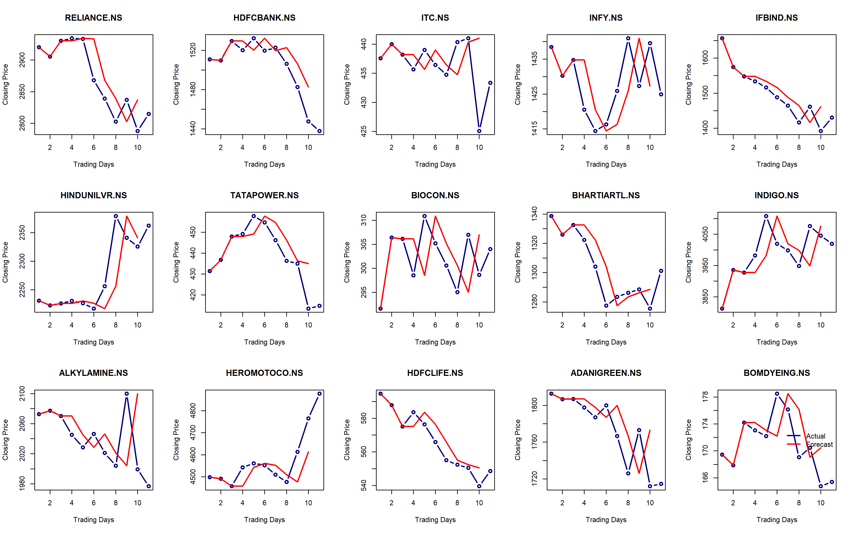

10 Trading-days’ Performance
For Reliance,
MAPE = 1.04%
RMSE = 43.7
SNaive

Slide 17

Forecasting Agent 2
SARIMA agent uses the statistical forecasting model ARIMA famous for stationary time series modelling using past values of the series (auto-regressive) and past errors (moving-average).
Seasonal ARIMA

Slide 18
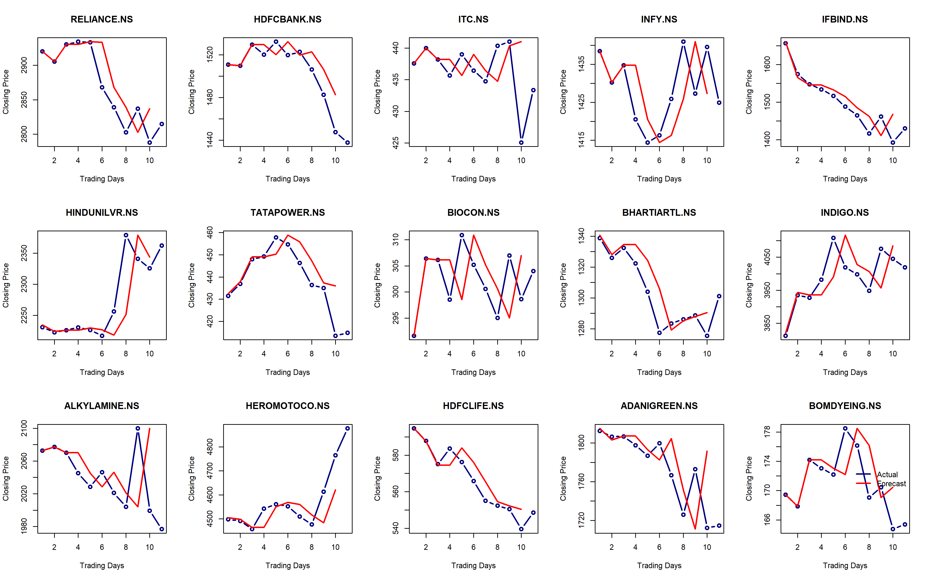
10 Trading-days’ Performance
For Reliance,
MAPE = 1.04%
RMSE = 43.7
SARIMA

Slide 19

Forecasting Agent 3
Support Vector Machine, a supervised Machine Learning Model able to capture non-linear relationships in the time series based on lagged values.
Support
Vector
Machine
We train everyday with including new data – online learning approach.

Slide 20
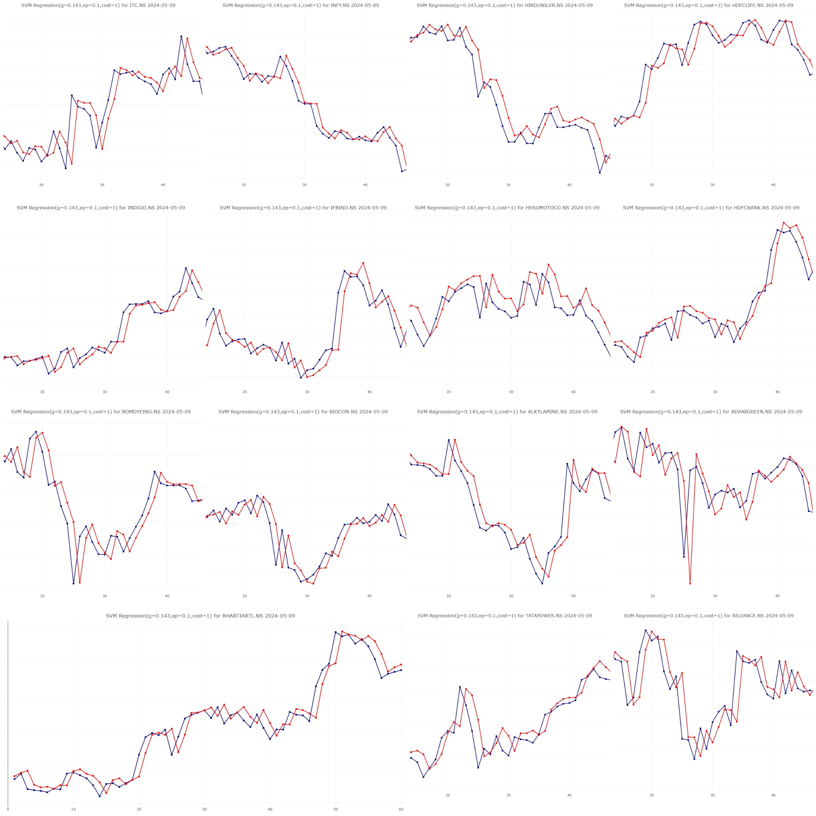
60 Test-days’ Performance
SVM
For Reliance, 5th May 2024
MAPE = 0.84%
RMSE = 31.48

Slide 21
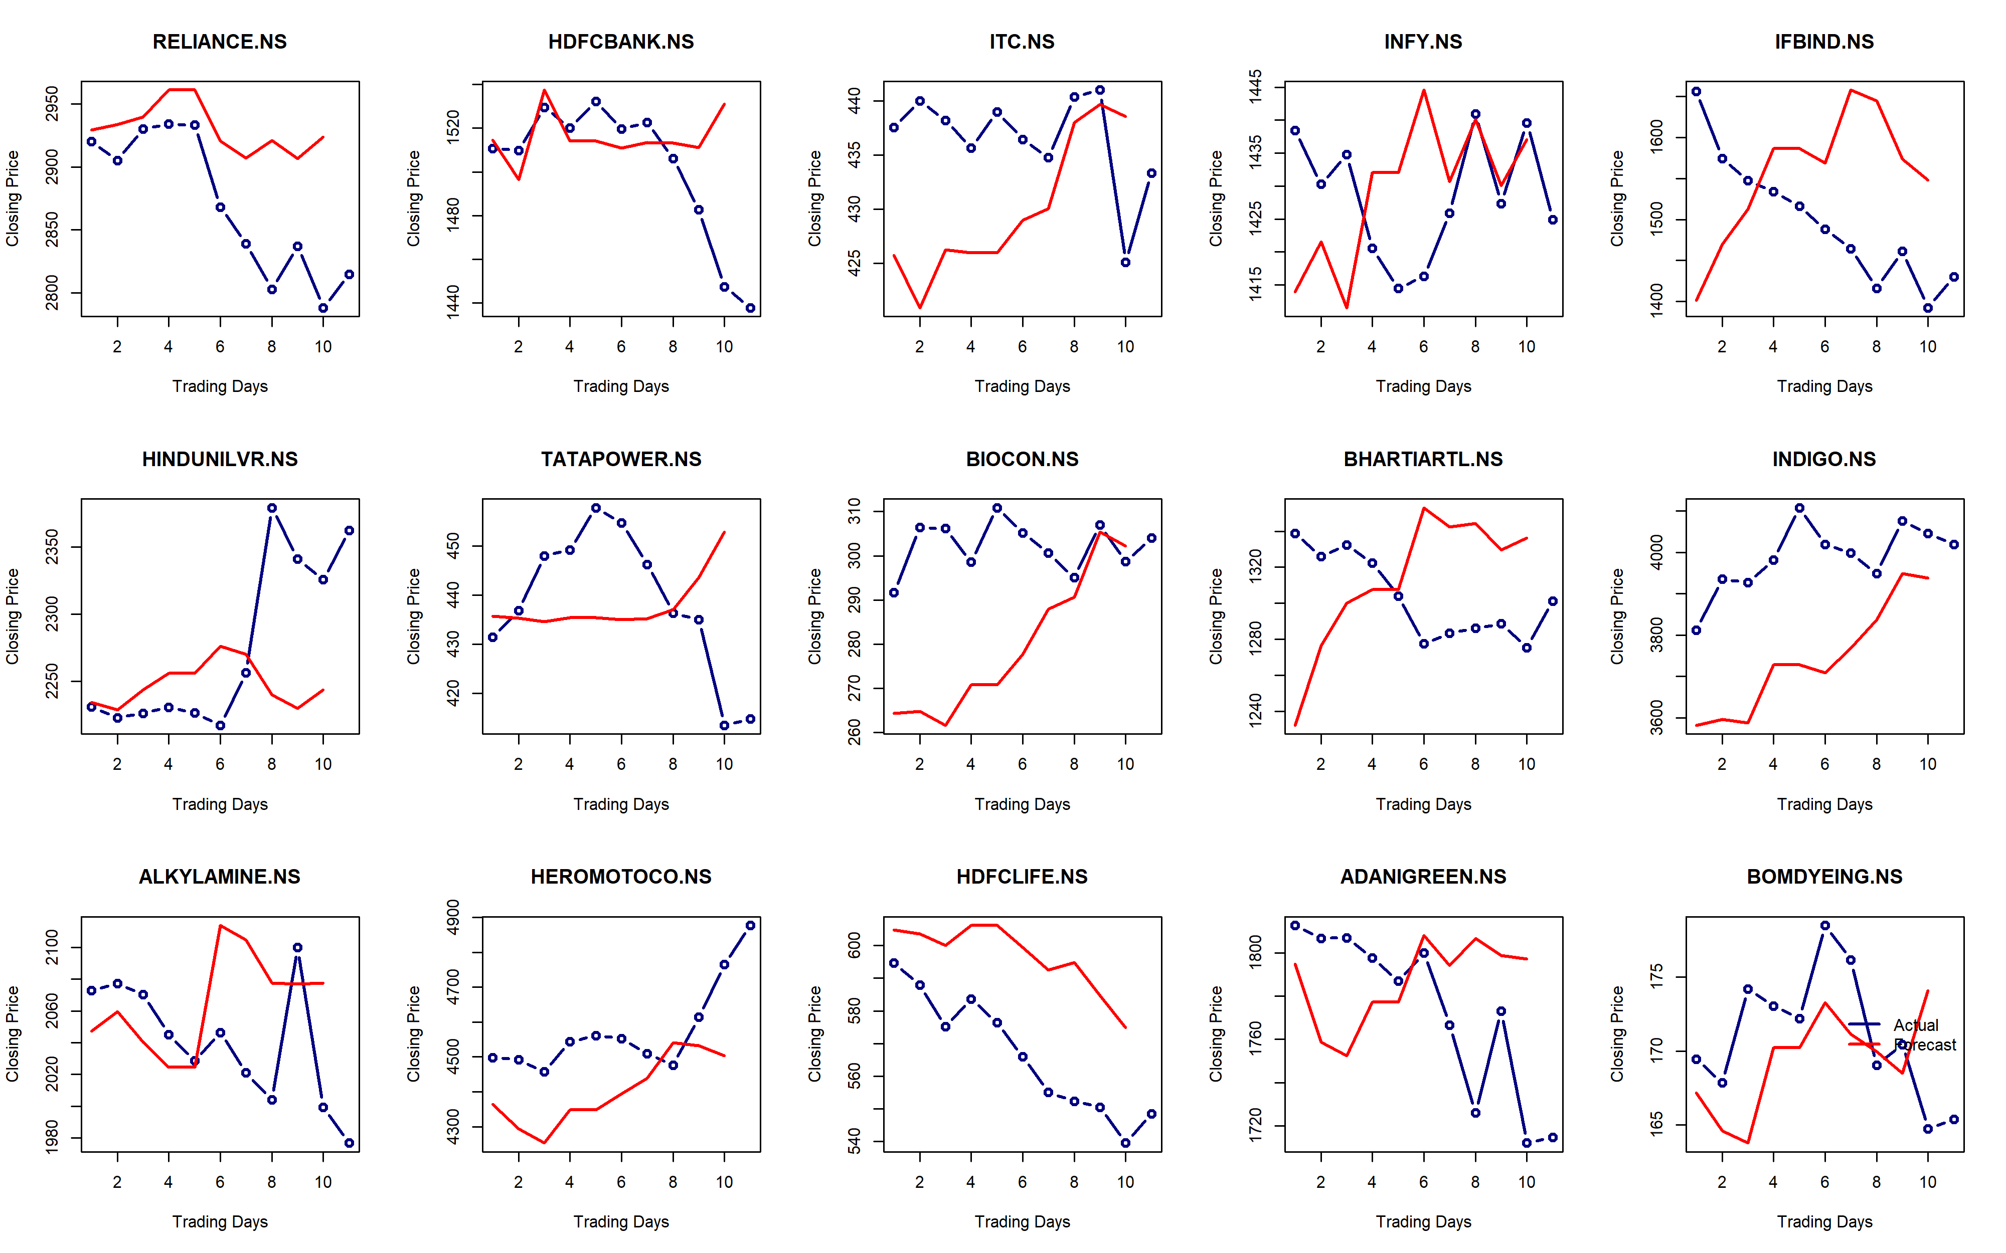
10 Trading-days’ Performance
For Reliance,
MAPE = 2.1%
RMSE = 73.9
SVM

Slide 22
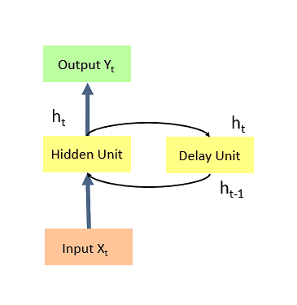

Forecasting Agent 4
Elman Neural Network is simple recurrent NN which remembers the hidden state values in previous time step.
Elman
Neural
Network
We perform Grid Search to find the best structure.

Slide 23
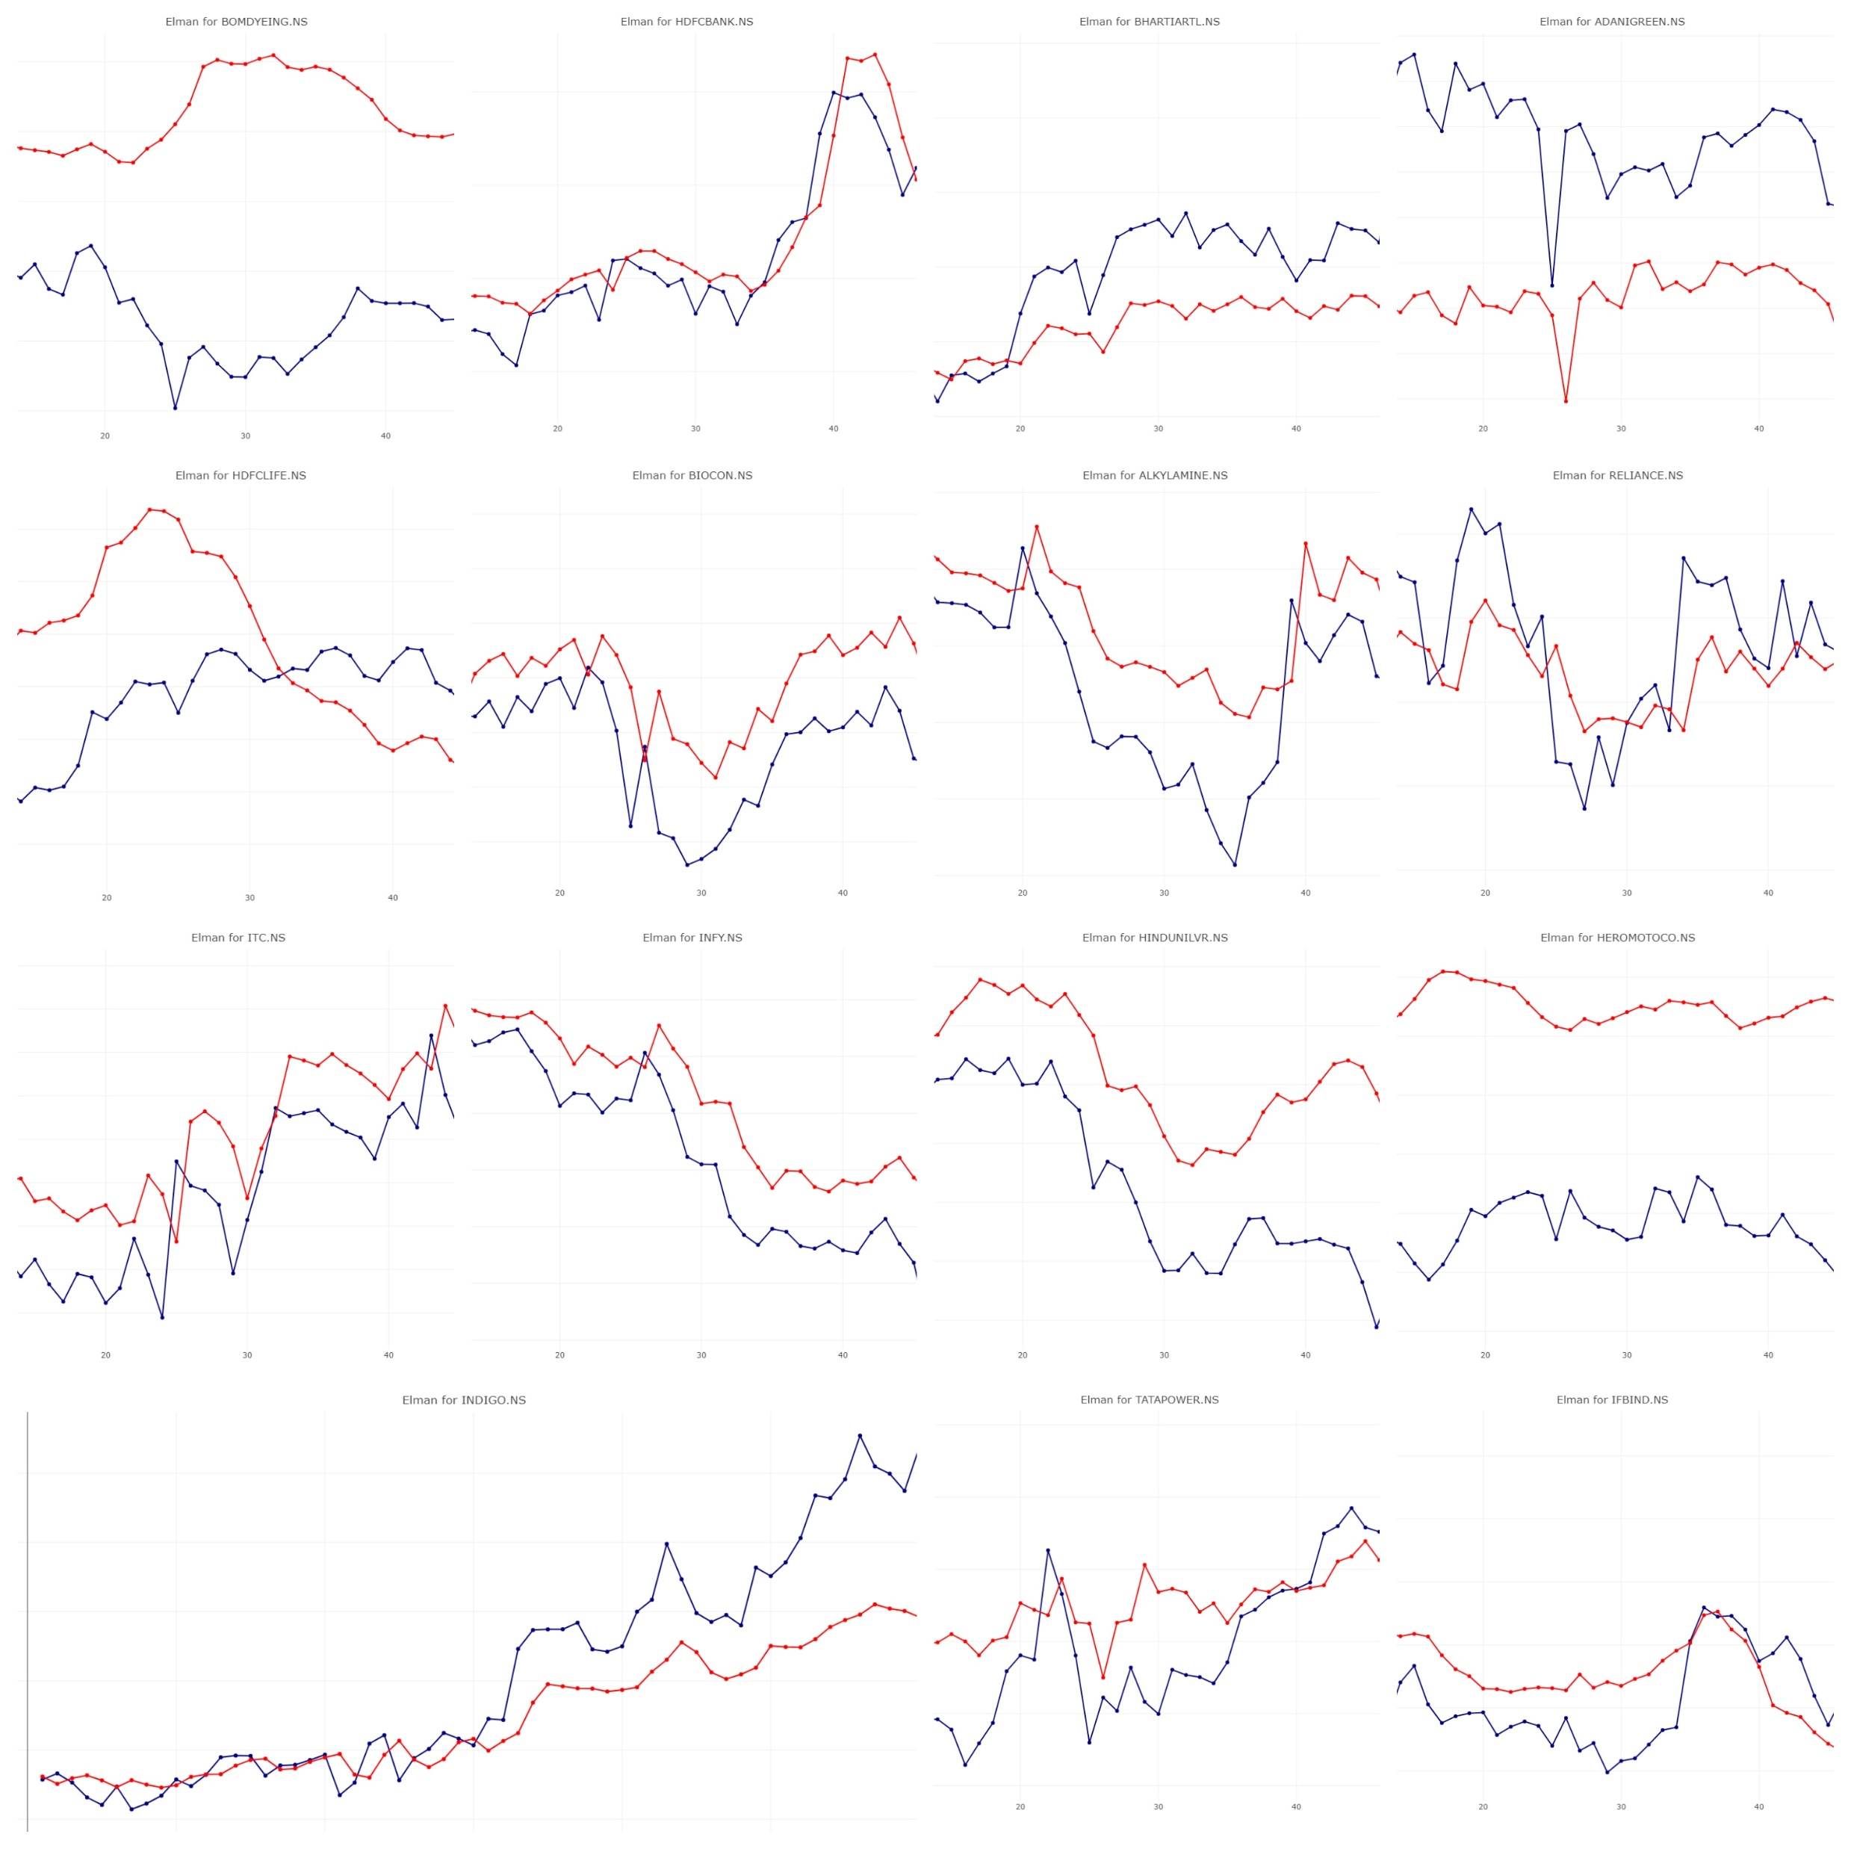
60 Test-days’ Performance
For Reliance, 5th May 2024
19, 6 Hidden Units
MAPE = 0.81%
RMSE = 30.8
Elman

Slide 24
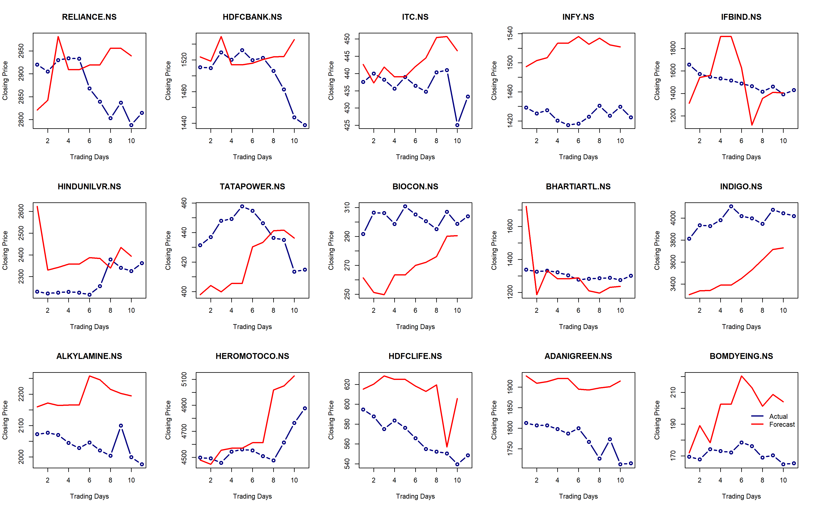
10 Trading-days’ Performance
For Reliance,
MAPE = 2.6%
RMSE = 88.9
Elman

Slide 25
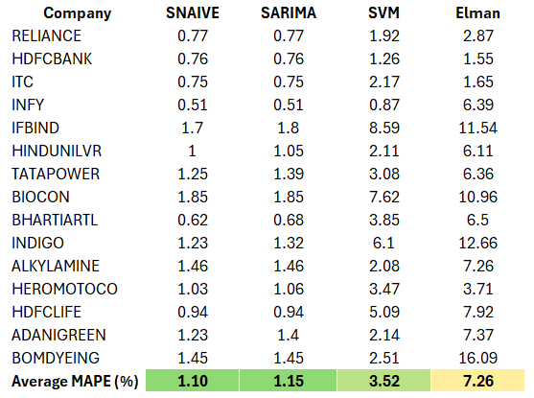
Best Forecaster?
Let’s compare the performance on our 10-day trading window by looking at average MAPE.
SNaive and SARIMA has the lowest error followed by SVM & Elman Neural Networks.
Mean Absolute % Error (MAPE)
Should we simply use the Naïve prediction strategy?
No.
The best portfolio performance will depend on how the forecaster and optimizers interact.
To be revealed…

Slide 26

Portfolio Optimization Agents

Slide 27
Portfolio Optimization (PO) Agents
Naïve
Minimum
variance
Maximum
sharpe ratio
RISK
PARITY
PORTFOLIO

Slide 28
Naïve PO Agent
We simply invest equal amounts in all 15 companies.
Hold all shares.
Naïve Portfolio

Slide 29
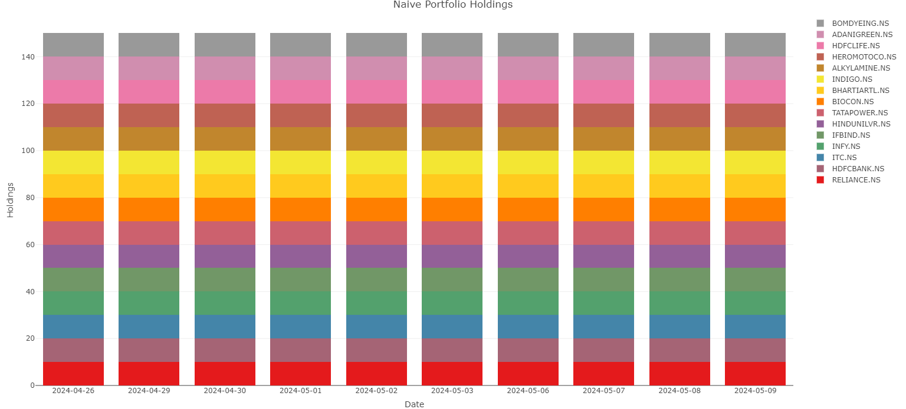
Naïve PO Agent
Naïve PO Agent for Elman Family

Slide 30
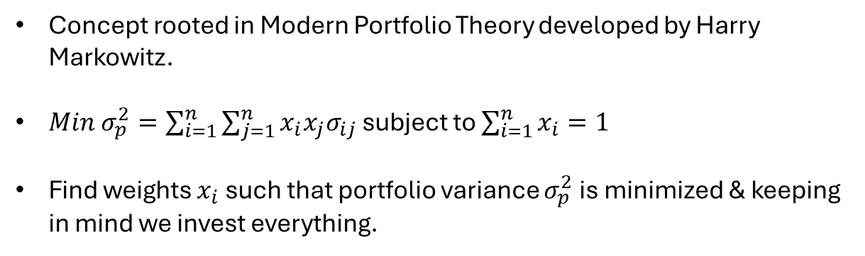
Min_Var PO Agent
Concept rooted in Modern Portfolio Theory developed by Harry Markowitz.
$Min σ_{p}^{2}=\sum_{i=1}^{n}{\sum_{j=1}^{n}{x_{i}x_{j}σ_{ij}}}$ subject to $\sum_{i=1}^{n}{x_{i}=1}$
Find weights $x_{i}$ such that portfolio variance $σ_{p}^{2}$ is minimized & keeping in mind we invest everything.
Minimum Variance

Slide 31
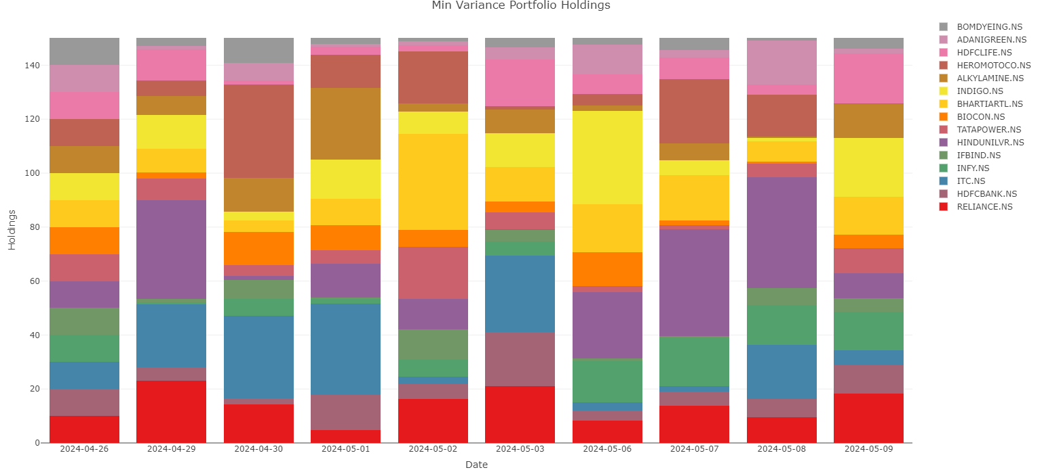
Min_Var PO Agent
Min_Var PO Agent for Elman Family

Slide 32
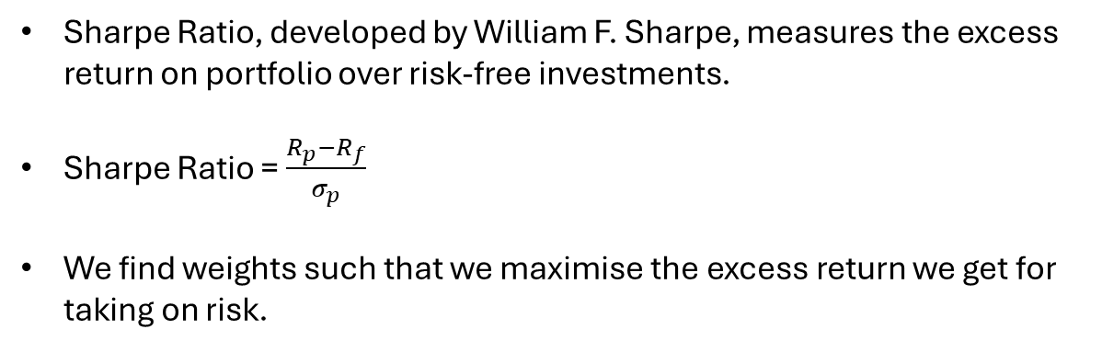
Max_SR PO Agent
Sharpe Ratio, developed by William F. Sharpe, measures the excess return on portfolio over risk-free investments.
Sharpe Ratio = $\frac{R_{p}−R_{f}}{σ_{p}}$
We find weights such that we maximise the excess return we get for taking on risk.
Maximum Sharpe Ratio

Slide 33
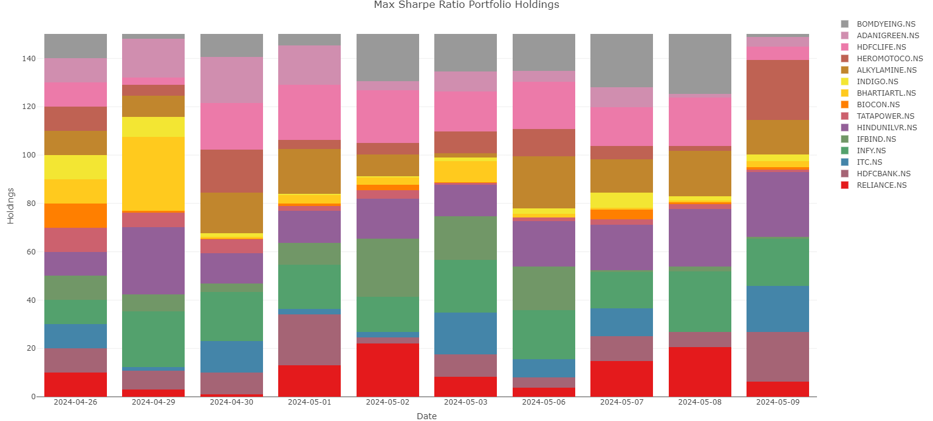
Max_SR PO Agent
Max_SR PO Agent for Elman Family

Slide 34
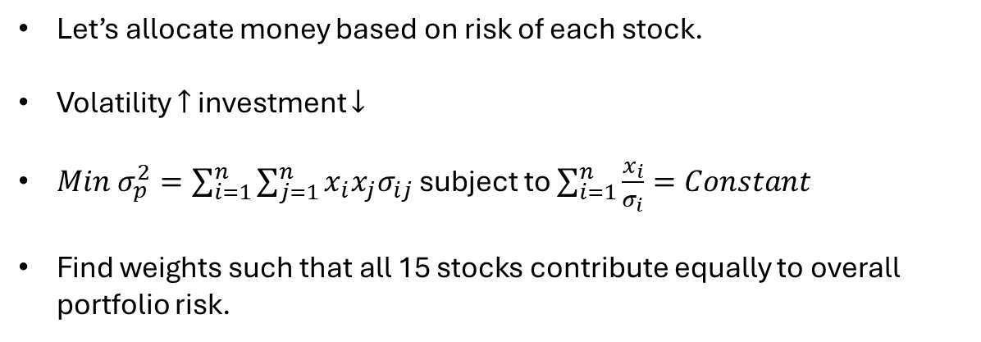
Risk_PP PO Agent
Let’s allocate money based on risk of each stock.
Volatility $↑$ investment $↓$
$Min σ_{p}^{2}=\sum_{i=1}^{n}{\sum_{j=1}^{n}{x_{i}x_{j}σ_{ij}}}$ subject to $\sum_{i=1}^{n}{\frac{x_{i}}{σ_{i}}=Constant}$
Find weights such that all 15 stocks contribute equally to overall portfolio risk.
Risk Parity Portfolio

Slide 35
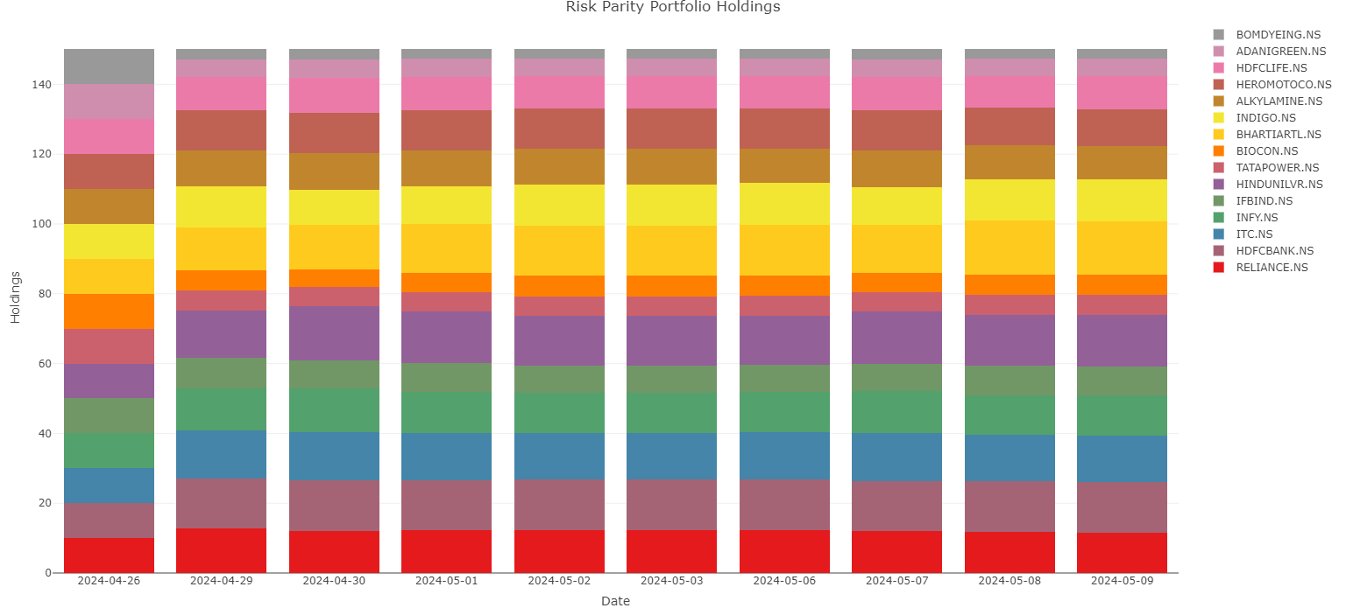
Risk_pp PO Agent
Risk_pp PO Agent PO Agent for Elman Family

Slide 36

Hey, but how are these weights determined?

Slide 37

Monte Carlo Simulation
Every day we simulate 50,000 portfolios with different weights.
Then pick the best ones.

Slide 38
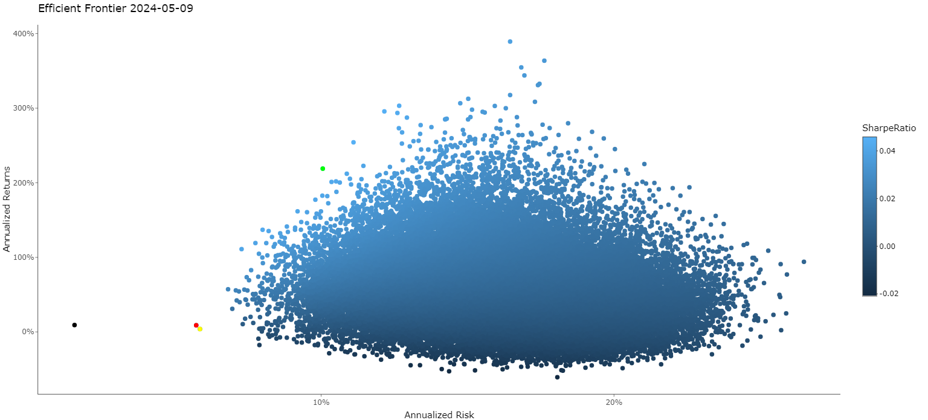
Efficient Frontier
Efficient Frontier 2024-05-09 for SARIMA Family
Max SR
Risk Parity
Max Var

Slide 39

Trading Agent
The system updates portfolio weights daily.
Some shares are sold, some are bought.
The total holding is maintained at 150 shares.
Portfolio value is updated when market closes everyday.

Slide 40
Hey, how do you determine when to buy or sell these shares everyday?

Slide 41

We use a stop-loss validation of 2%.
We sell if price is 2% higher than opening price & buy at 2% lower.
Otherwise, there is no trade.
Stop Loss Validation
Cool!

Slide 42

Evaluation I
Portfolio Value
Over a span of 10 days, we see how the agents have performed by monitoring the portfolio values, evaluated at actual closing price after market closes every day.

Slide 43
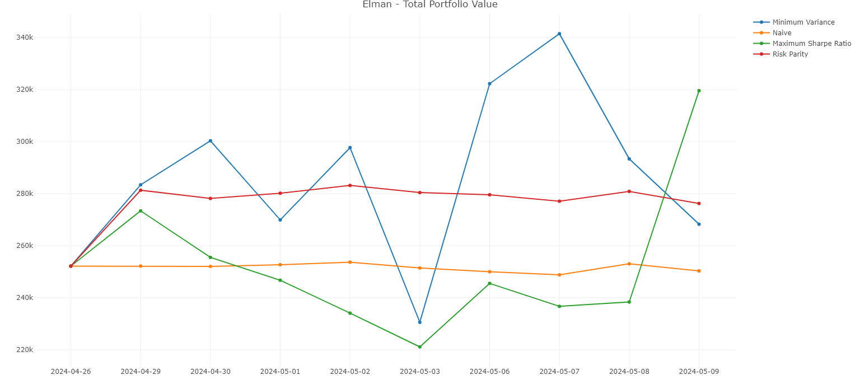
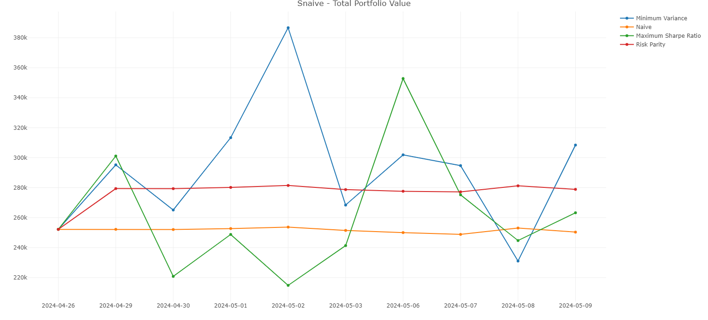
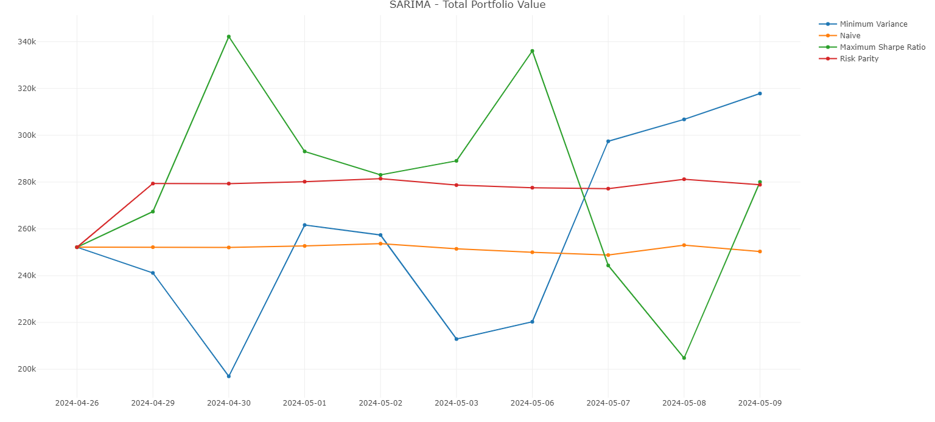
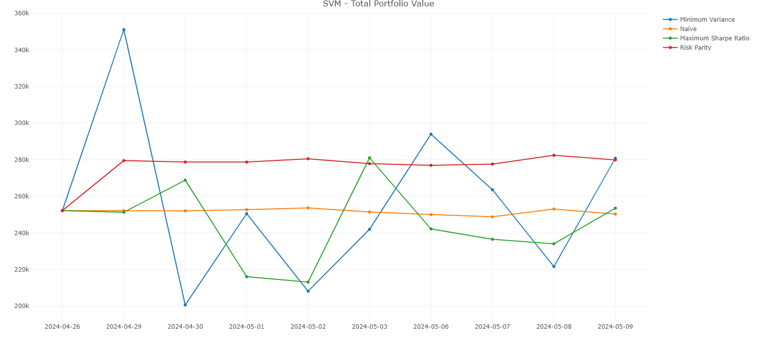
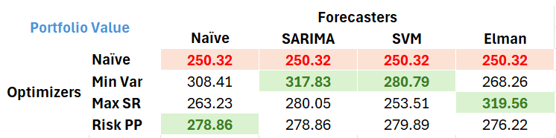
Daily Portfolio Value
Starting Portfolio value: Rs. 252k
Elman Family
Naive Family
A lot of variation within forecaster families.
Highest portfolio value is achieved by Elman family with Max SR PO Agent
Family wise highest portfolio values are highlight green.
SARIMA Family
SVM Family
Portfolio Values on 9th May

Slide 44


Well, how much did we profit !!

Slide 45

Evaluation II
Profit (Unrealized)
Profit = New Portfolio Value – Transaction Amount – Old Portfolio Value
Note:
Transaction amount is the total of funds spent and released due to buy/sell or rebalancing of portfolio.
If transaction amount is positive, the investor had to “inject” cash into the portfolio, otherwise “siphon-off” cash.
This profit is unrealized, it will be realized if Mr. Harilal decides to liquidate the portfolio.

Slide 46
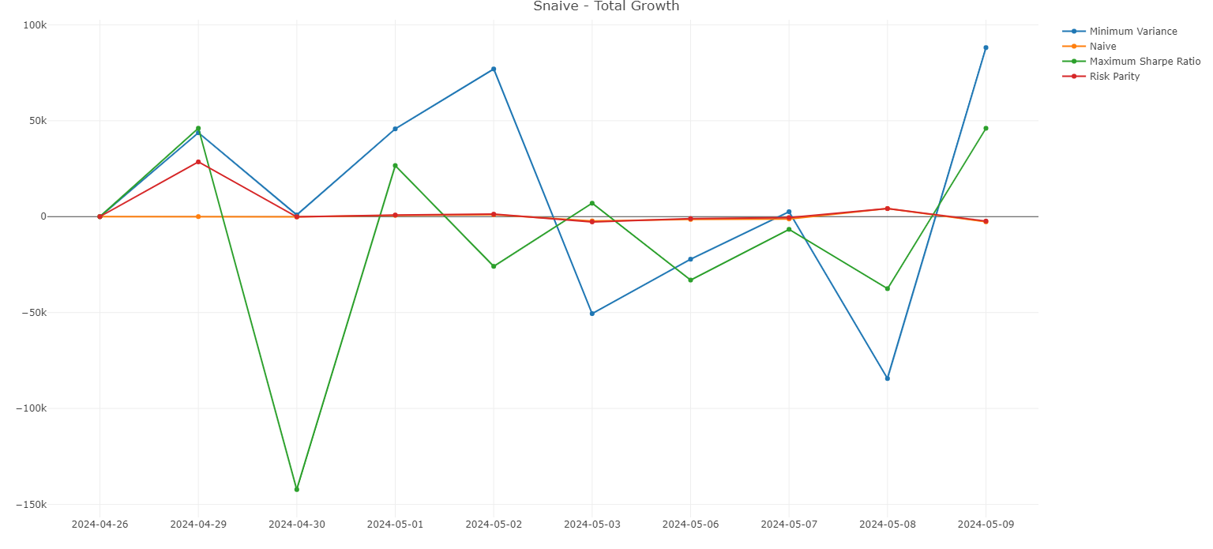
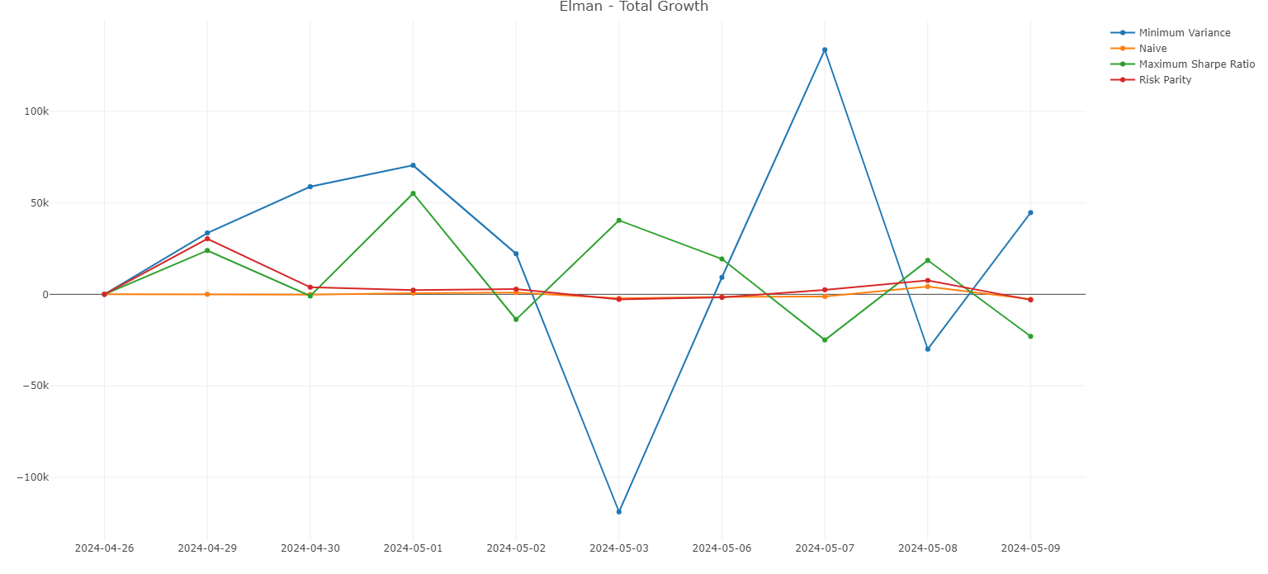
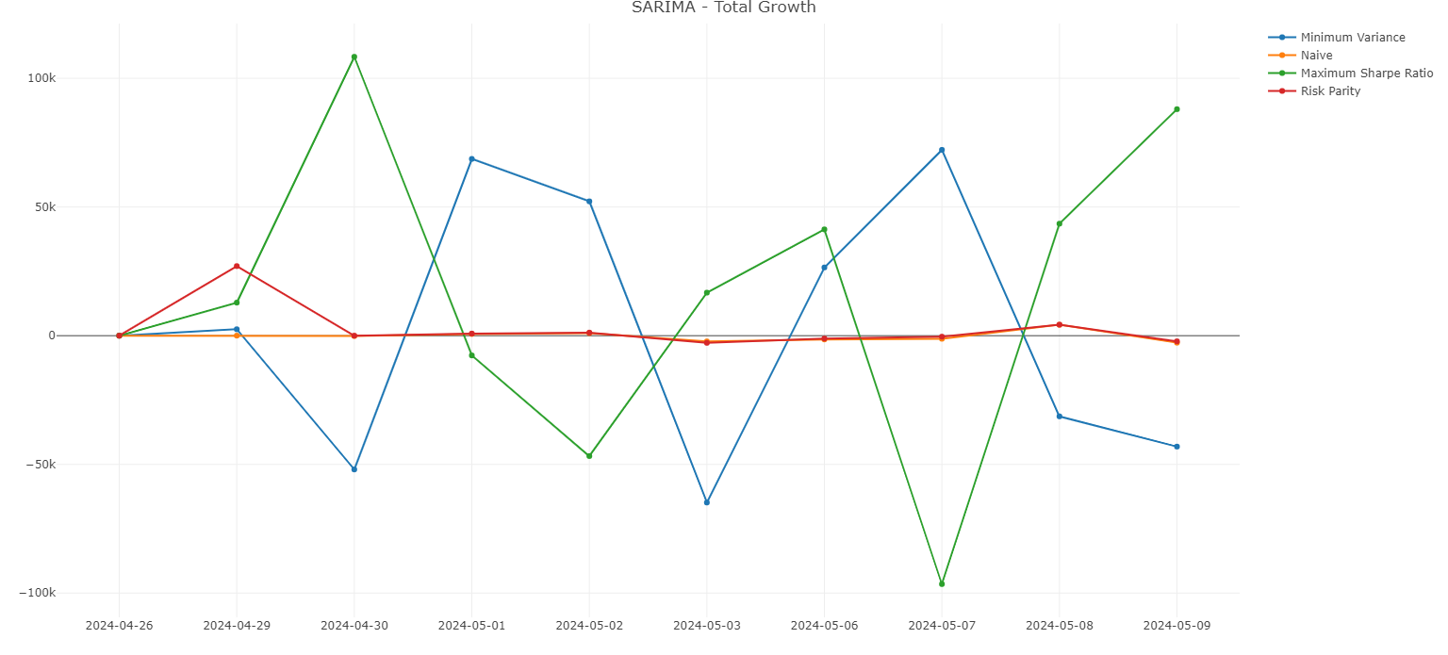
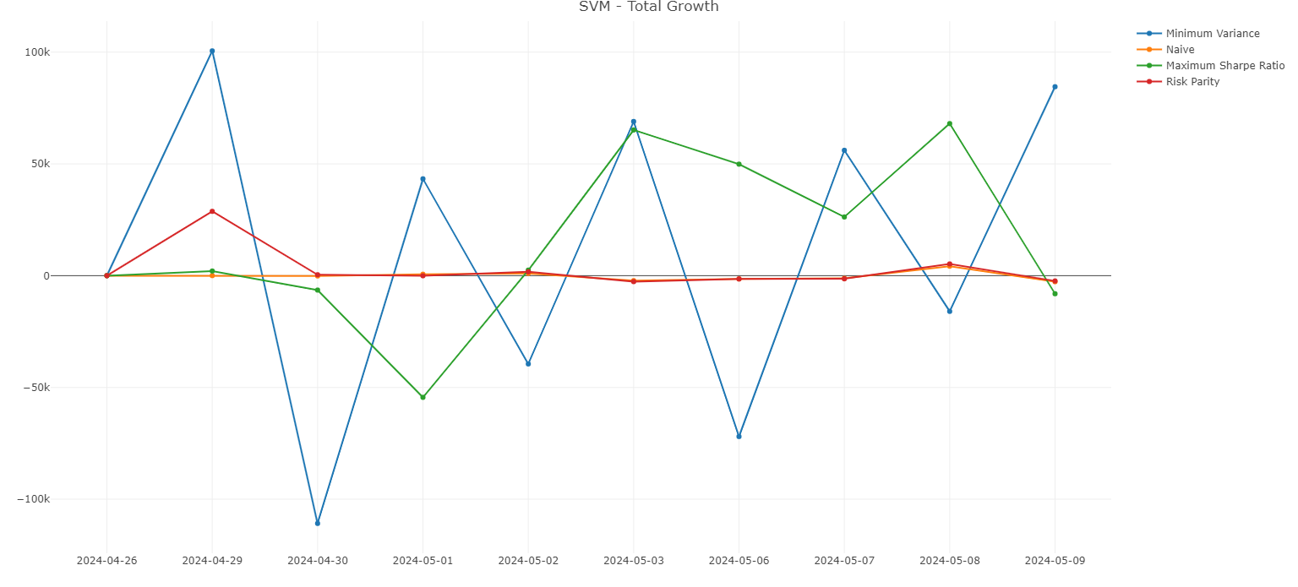
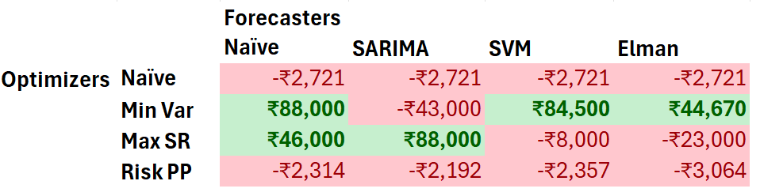
Unrealized Daily Profit/Loss
Naïve Family
Elman Family
Unrealised Daily Profit/Loss values vary a lot with forecasting and optimisation agents.
SARIMA Family
SVM Family
The Investor will be suggested to sell the portfolio only if there is an unrealised profit.
At end of 10 days, the highest profit is around Rs 88,000.
What’s the profit at end of 10 days?

Slide 47
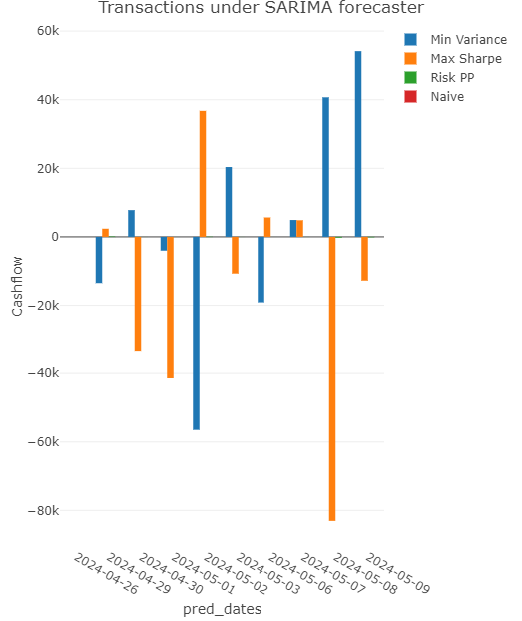
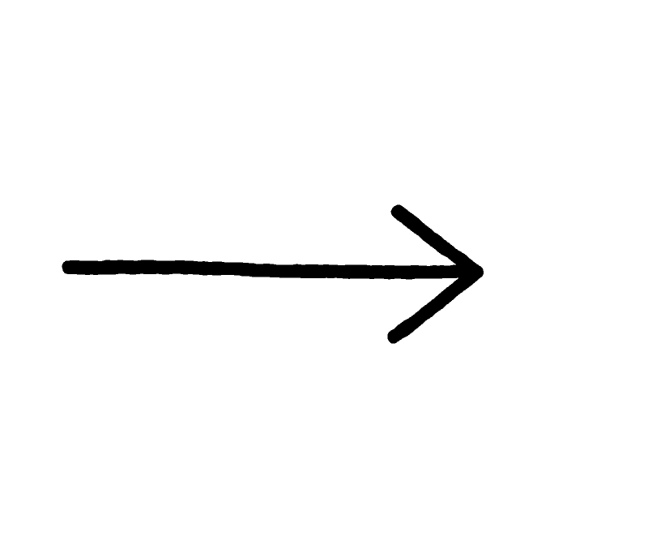
Evaluation III
Buy more
Buy/Sell Tendency
Let’s look at the daily net transactions.
Note:
A bar going up indicates we bought more shares by investing money.
A bar going down indicates we liquidated shares.
Sell more

Slide 48
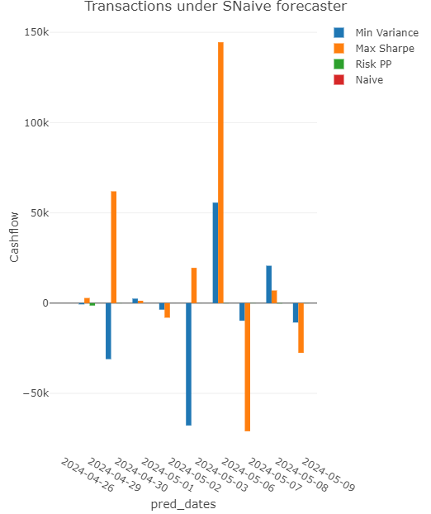
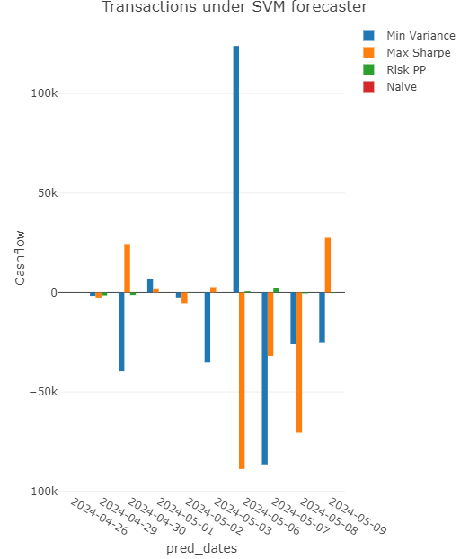
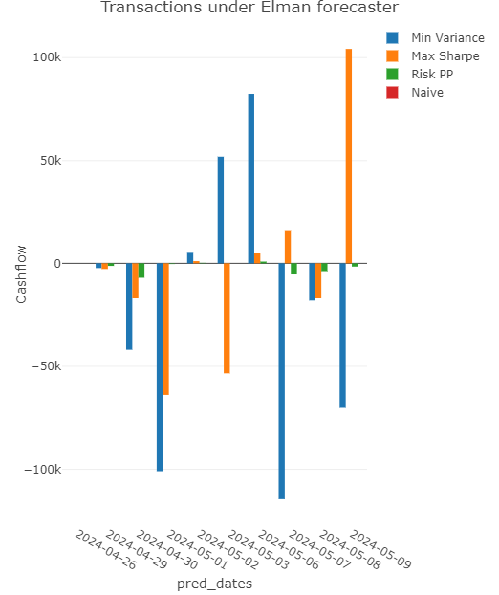
Net Transactions
SARIMA Family
SNaive Family
SVM Family
Elman Family
Buy Rs. 54k
Buy Rs. 144k
Buy Rs. 123k
Buy Rs. 104k
Sell Rs. 83k
Sell Rs. 70k
Sell Rs. 114k
Sell Rs. 88k
Naïve PO Agent does not participate in the market (makes sense, Long Hold Strategy).
Risk Parity PO Agent’s transactions are very few (based on annualised covariance of portfolio).
All agents have similar buying/selling tendency.

Slide 49

Evaluation IV
But How did the Market Perform?
Let’s now look at how the Market Performed in these last 10 days by looking at NIFTY50.
Note:
NIFTY50 is a benchmark stock market index in India – takes the weighted average of 50 largest Indian companies in NSE.

Slide 50
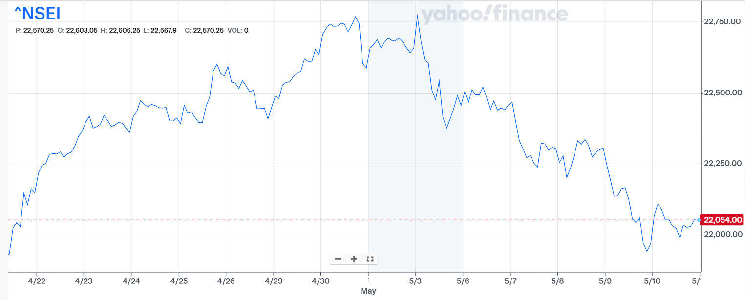

NIFTY50 Performance
The Market is falling !

Slide 51
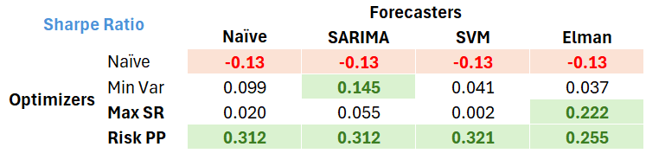
Sharpe Ratio measures excess return per unit risk. Higher the better.
Naïve PO Agents consistently underperforms
Min Var PO Agents vary a lot – sensitive to forecaster choice (SARIMA best)
Max SR PO Agent best with Elman
Risk PP PO Agent highest among all portfolios. Best in balancing risk.
Evaluation V
Sharpe Ratio

Slide 52
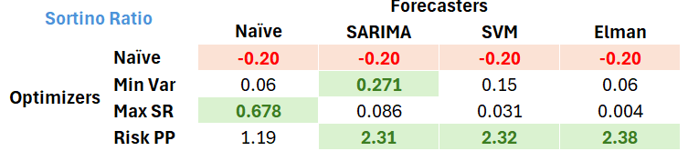
Sharpe Ratio focuses on downside volatility rather than total standard deviation.
Naïve PO Agents consistently underperforms.
Min Var PO Agents vary a lot – sensitive to forecaster choice (SARIMA best)
Max SR PO Agent best with Elman.
Risk PP PO Agent highest among all portfolios. Best in balancing downside risk. Suitable for risk-averse investors.
Evaluation VI
Sortino Ratio

Slide 53


Thank you
Kunal Choudhary
20590121
COMP4105 Designing Intelligent Agents

